Slide 1
ANALYTICAL CHEMISTRY
SOLVENT EXTRACTION METHODS

Slide 2
Solvent extraction
Solvent extraction is a method to separate compounds based on their relative solubilities in two different immiscible liquids, usually water and an organic solvent. It's advantageous to do extraction in successive stages using smaller lots of solvents rather than doing extraction once using the entire lot.

Slide 3
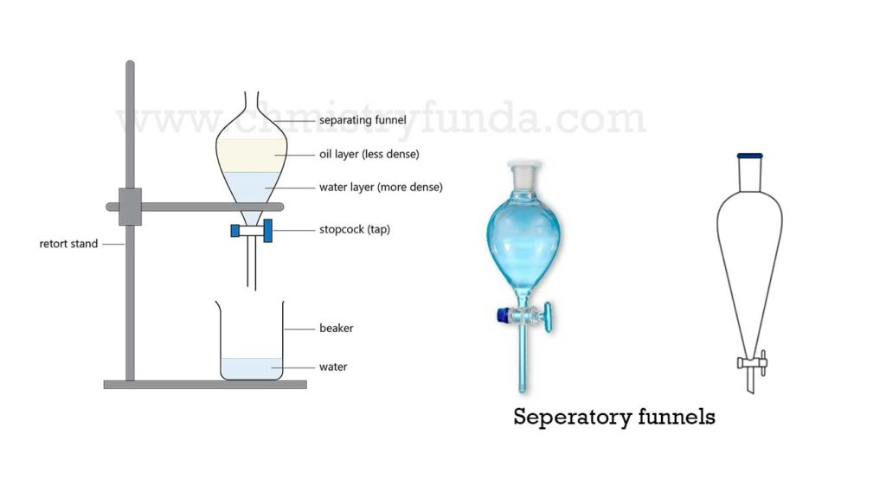

Slide 4
Nernst Distribution law
“At constant temperature, a solute distributes itself between two immiscible solvents only in a particular ratio”
This statement is a Nernst Distribution Law – i.e. the law that determines the relative distribution of a component that is soluble in two liquids, these liquids being immiscible or miscible to a limited extent.

Slide 5
Nernst Distribution law
This law is one of the laws applying to ideal dilute solutions. It was discovered by W. Nernst in 1890. The Nernst distribution law states that, at equilibrium, the ratio of the concentrations of a third component in two liquid phases is constant.
The law may be expressed in the form
c₁/c₂ = k
where c₁ and c₂ are the molar equilibrium concentrations of the third component in the first and second phase, respectively; the constant k is the distribution coefficient, which is temperature dependent.

Slide 6
Nernst Distribution law
The Nernst distribution law permits us to determine the most favorable conditions for the extraction of substances from solutions.
If the dissolved compound in one of the solvents can associate, the number of molecules becomes half.
The ratio c₁/c₂ is not stable at constant temperature.

Slide 7
Limitations
Temperature
Molecular state of the solute is same
Solvents are mutually insoluble
Dilute solutions

Slide 8
EXTRACTION PROCESS
Extraction depends on the process of selective removal of one or several components from a mixture of liquid or solid samples with an organic solvent known as EXTRACTANT.
Extraction of solids with a liquid is also known as SELECTIVE DISSOLUTION.

Slide 9
PARTITION COEFFICIENT K DEPENDS ON
Chemical nature of substance being extracted.
Nature of solvents.
Temperature
DISTRIBUTION COEFFICIENT D is the ratio of total concentration of all species of the solute in one solvent to the total concentration of all its species in the other solvent.

Slide 10
LIQUID LIQUID EXTRACTION
In these separations, the advantage is taken of the fact that the distribution ratio of most inorganic substances is in the favour of water, while those of organic compounds is in favour of organic solvents
Sometimes , the distribution ratio can be increased in the desired direction by adding another compound which decreases the solubility of the substance being extracted in the original solvent.

Slide 11
LIQUID LIQUID EXTRACTION
It is very easy to show that with a given volume of extracting solvent available, the extraction is more complete, if it is used in several operations than if it is used all in one operation.
In the first extraction 66.7% solute is extracted and in second extraction 88.9% is extracted.
Hence, in solvent extraction it is advantageous to use a given volume of the extracting solvent in small amounts in successive stages rather than in one whole at a time.

Slide 12
Extractants
A good extracting liquid must have:
  High distribution ratio for the solute
  Low solubility in aqueous phase
  Low toxicity and inflammability
  Low viscosity
  Density difference

Slide 13
Extractants
  Selective
  Chemically inactive
  Cheap
  Blast resistant
  Low oxidizability
  Easy to recover

Slide 14
Extractants
Types of Extractants
Lighter than water
Heavier than water

Slide 15
Factors promoting rate and selectivity of an extraction process
Proper choice of extractant
Adjusting pH
Regulating temperature
Masking interfering ions
Changing concentrations
Duration of extraction process
Effect of processes

Slide 16
Factors Affecting Extraction
Salting out agents
pH value
Modifiers
Oxidation state
Masking agents
Synergistic agents

Slide 17
TECHNIQUE FOR SOLVENT EXTRACTION
Batch extraction | Continuous extraction
Large distribution ratio for the desired separation is readily available | Distribution ratio is low
Given volume of a solution containing the ion under analysis is shaken with a given volume of the organic solvent in separatory funnel | Continuous flow of immiscible solvent through the solution to be extracted
Micro as well as macro pear type separatory funnels are available | Removal of extracted solute from the organic phase for further preparation for the detailed analysis is called STRIPPING
 | Impurities present in organic phase may be removed by BACK WASHING

Slide 18
QUANTITATIVE TREATMENT OF SOLVENT EXTRACTION EQILIBRIA
It is asssumed that
1.No effect of solvation
2.Reagent and metal complex salt exist in both phases.
3.Solute very low concentration and are uncharged molecules.
The distribution of metal in a given system is a function of pH alone.

Slide 19
CLASSIFICATION OF SOLVENT EXTRACTION SYSTEMS
High ideal behaviour
Ideal behaviour
Non-ideal behaviour

Slide 20
TYPES OF EXTRACTION SYSTEMS
Ionic extractant
Basic extractant
Chelating extractant
Inert solvent
Acidic extractant

Slide 21
TYPES OF INORGANIC EXTRACTION SYSTEMS
Ion-association system
Chelate system

Slide 22
TRANSITION OF SOLUTE FROM AQUEOUS PHASE TO ORGANIC PHASE
Organic substances inorganic substances with covalent bond
Ion pairs
Solvated compounds
Chelates

Slide 23
ADVANTAGES OF SOLVENT EXTRACTION
Low time
More complete separation of ions
Increase in sensitivity
Extractant selected helps in removal and separation of substances.
Separation combined with quantitative determination.
Extract contains more stable compound.
Low temperature and automatic
Selectivity of reactions can be increased.

Slide 24
APPLICATIONS OF LIQUID EXTRACTION
Useful in Analytical process
1.Determination of Fe as 8-hydroxy quinolalate
2.U as 8-hydroxy quinolate
3.Ni as dimethyl glyoxime complex
4.Iron chloride extractions
5.Pb by dithiozone method
6.Cu as diethyl dithiocarbamate complex
7.Cu as neo cuproin complex
8.Be as acetyl acetone complex
9.Mo by thiocynate method

Slide 25
SOLVENT EXTRACTION METHODS IN METALLURGY
1.Extraction of metal from leach liquors obtained from complex ores.
2.Separation of metals that are difficult to be separated by pyro and hydro-metallurgical techniques.
3.Purification in order to obtain a very pure starting material for further metallurgical processing.
e.g uranium, lanthanides,tantalum,zirconium and thorium nitrate

Slide 26
SOLID LIQUID EXTRACTION
1.Discontinuous infusion type extractor
Soxlet apparatus is used
2.Continuous infusion type extractor
In this extractor the substance is placed on sintered glass plate.
Apparatus is available commercially.
The separation of lithium chloride from sodium and potassium chlorides may be carried out by making use of n-butyl alcohol because only lithium chloride is soluble in n-butyl alcohol.

